Slide 1
Network Design Essentials
Chapter 2

Slide 2
Learning Objectives
Design a network layout
Understand various networking topologies
Integrate hubs into your networks
Integrate of switches into your network
Explore variations of standard networking topologies
Select best network topology for your environment
Construct your network layout

Slide 3
Network Design
Good network design includes:
Analyzing network requirement
Selecting a network topology
Selecting equipment to fit that topology

Slide 4
Designing a Network Layout
Topology refers to physical layout including computers, cables, and other resources
Determines how components communicate
Basic network design is referred to as topology, layout, diagram, and map
Physical topology refers to arrangement of cabling
Logical topology refers to how data travels between computers on the network
Network may use one physical topology but a different logical topology to pass data

Slide 5
Designing a Network Layout
Topology affects network’s performance and growth potential
Topology determines type of equipment to purchase and how to manage network
When designing a network, you must understand different topologies
Consider growth and security requirements
Good design grows and adapts as needs change

Slide 6
Standard Topologies
Today’s network designs are based on three topologies:
Bus consists of series of computers connected along a single cable segment
Star connects computers via central connection point or hub
Ring connects computers to form a loop

Slide 7
Bus
Simplest topology
Components connect via backbone or single cable segment
See Figure 2-1
Major weakness is single cable break can halt entire network

Slide 8
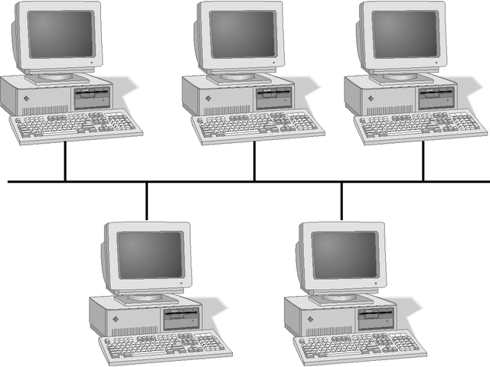
Bus Topology Network

Slide 9
Sending the Signal
All computers, regardless of topology, communicate by addressing data to one or more computers and transmitting it across cable as electronic signals
Data is broken into packets and sent as electronic signals that travel on the cable
Only the computer to which the data is addressed accepts it

Slide 10
Bus Communications
In bus topology, only one computer can send information at a time
Network performance slows as more computers are placed on the bus
Bus is a passive topology
Computers only listen for data being sent; not responsible for moving data to next computer
Failure of one computer has no effect on rest of network
In active topology, computers regenerate signals; move data through network

Slide 11
Signal Bounce
Signals move from point of transmission to both ends of any bus
Something must stop signals when they reach end of bus to avoid signal bounce
See Figure 2-2
Terminator attached to end of cable absorbs electronic signal, prevents signals from bouncing
See Figure 2-3

Slide 12
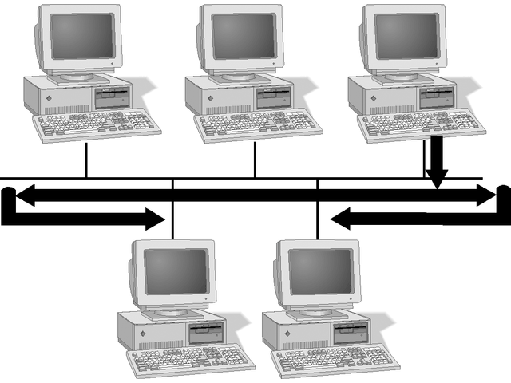
Signal Bounce

Slide 13
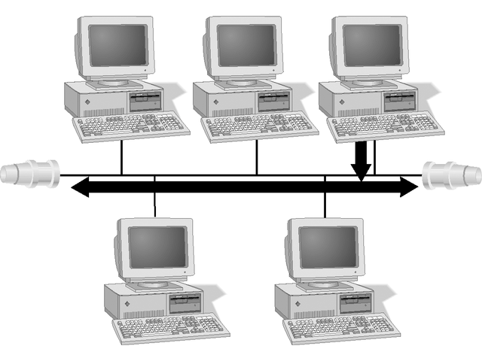
Terminated Bus Network

Slide 14
Cable Failure
Cable break means bus network is no longer terminated
Without termination, signals bounce and halt all network activity
See Figure 2-4

Slide 15
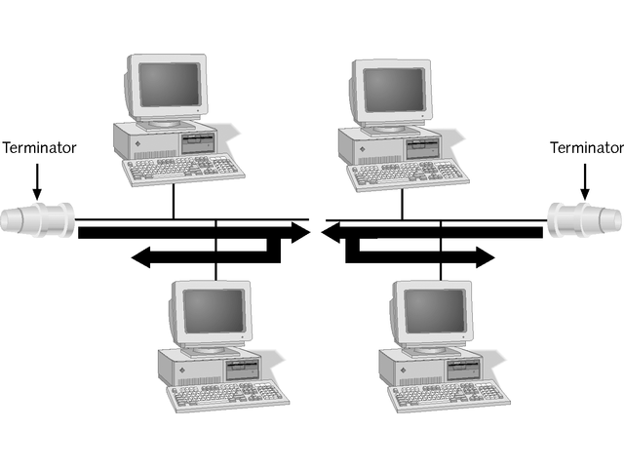
Cable Break

Slide 16
Bus Network Expansion
Easy to expand bus network by using Ethernet 10Base2 (thinnet) and BNC barrel connectors
Longer network segments can cause attenuation or weakening of signal
Repeater regenerates incoming signals to eliminate signal attenuation
Does not correct incoming errors
Bus topology not so popular because of single cable failure and troubleshooting and management problems

Slide 17
Star Topology
Dominant topology in today’s networks
See Figure 2-5
Connects computers to central hub that receives and transmits signals to all devices
Only computer to which packet is addressed processes it
Offers centralization of resources, but requires more cable and has single point of failure
If the hub fails, network is down, but failure of single computer or cable does not affect network
Easy to troubleshoot

Slide 18
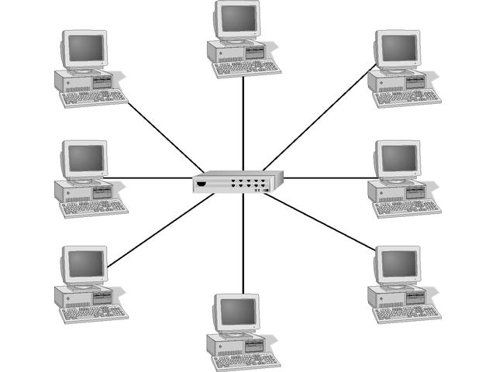
Star Network

Slide 19
Ring Topology
Computers attached in a circle with no termination necessary
Signals travel in one direction around ring
Each computer receives signal and passes it along
See Figure 2-6
Electronic token passes around ring with computer able to communicate only when it has token
May be physically wired as a star with central hub passing token in a circle

Slide 20
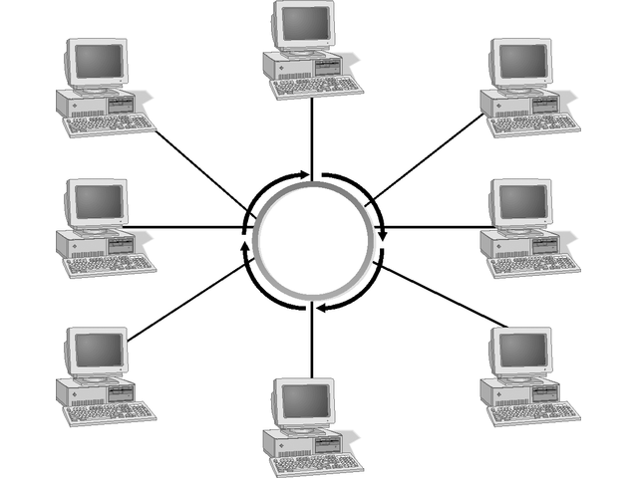
Ring Network

Slide 21
Ring Network
Some networks use dual counter-rotating rings for speed and redundancy
Fiber Distributed Data Interface (FDDI),
One computer failing can bring down single-ring network unless it has smart hub that automatically removes failed computer from ring
When one ring fails, dual ring network uses secondary ring and continues to work
Shares network resources equally

Slide 22
Wireless Topologies
Eliminate cables
Wireless LANs use centralized device similar to hub to control communication
Use star topology
Signals travel through one central device

Slide 23
Hubs
Central point of concentration for star network, as shown in Figure 2-7
May be active or passive
Active hub, also called a multiport repeater, regenerates signal and passes it along
Passive hub is simply central connection point, with no amplification or regeneration
Hybrid hubs maximize network’s efficiency by interconnecting different types of cables and topologies

Slide 24
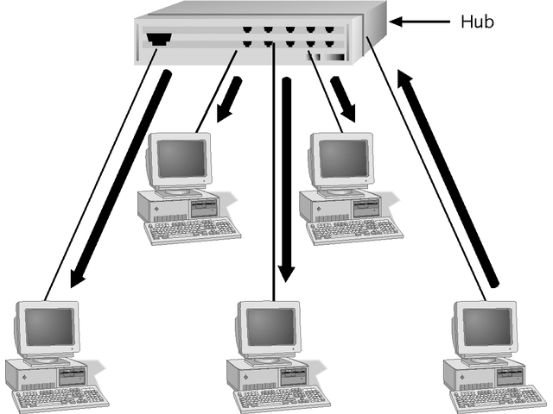
Hub Connection

Slide 25
Switches
Central connecting point for star topology network
Determines destination of message and sends it only to destination port
Provide full bandwidth to each station on network
Handle several conversations at once
More expensive than hubs
Provide better performance
Device of choice

Slide 26
Variations on the Major Topologies
Three variations of major network topologies are combinations of topologies
Mesh
Star Bus
Star Ring

Slide 27
Mesh Topology
Most fault tolerant topology
Offers multiple connections to each device
Uses intricate cabling configuration; every device connected to every other device in network
Expensive to implement
Internet is mesh topology with multiple paths to key junction points

Slide 28
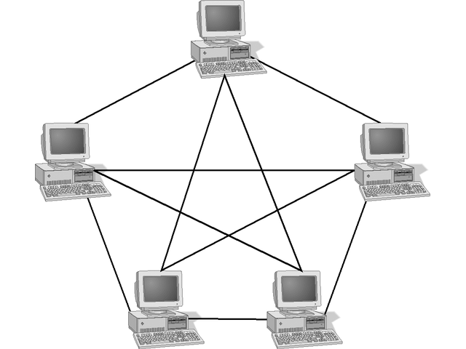
Mesh Topology

Slide 29
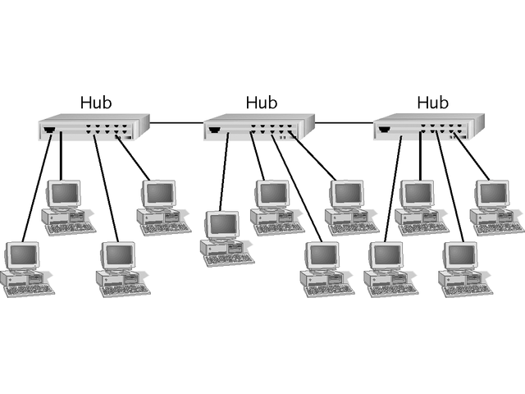
Star Bus Topology
Uses bus backbone
Interconnects two or more hubs

Slide 30
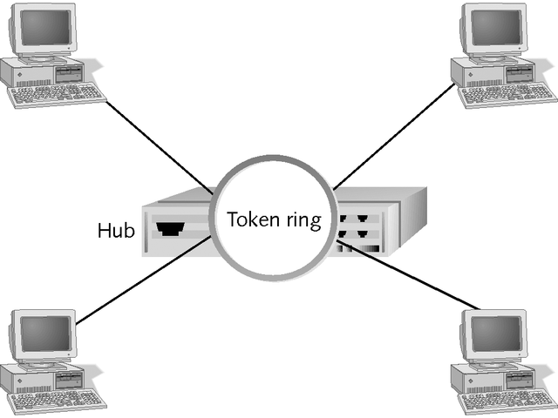
Star Ring Topology
Wired as star
Handles traffic like ring
Can have several outer hubs connected to inner hub
Single computer failure does not affect network

Slide 31
Selecting a Topology
When selecting network topology, consider many factors
Table 2-1 summarizes advantages and disadvantages of bus topology
Table 2-2 summarizes advantages and disadvantages of ring topology
Table 2-3 summarizes advantages and disadvantages of star topology

Slide 32
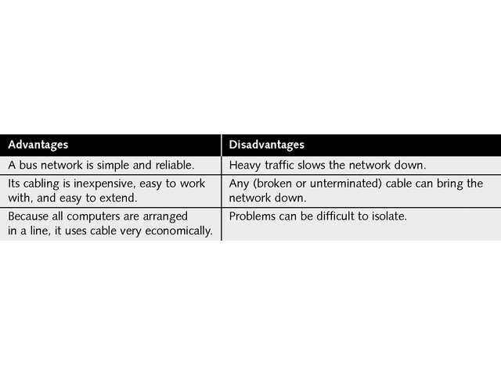
Advantages and Disadvantages of the Bus Topology

Slide 33
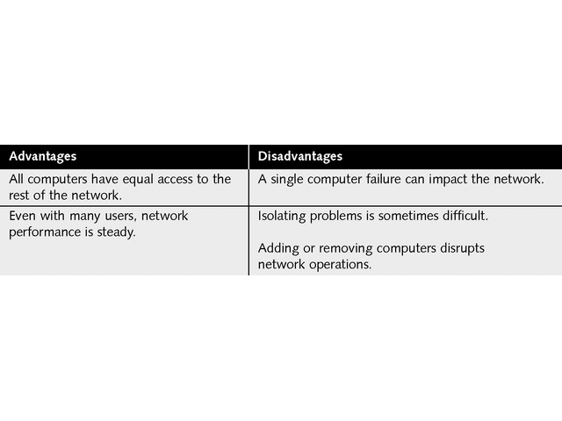
Advantages and Disadvantages of the Ring Topology

Slide 34
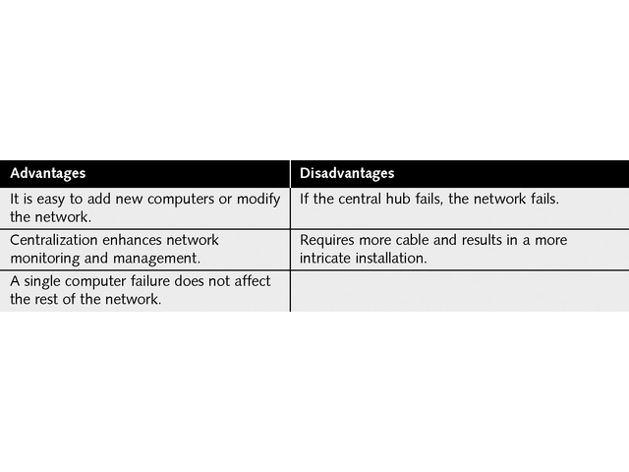
Advantages and Disadvantages of the Star Topology

Slide 35
Constructing a Network Layout
First step in network design is evaluating underlying requirements
Important questions to consider include:
How many clients will be attached?
How many servers will be attached?
What are company’s plans for expansion?
What kind of applications will run?
Will this be peer-to-peer or server-based network?
How much fault tolerance do applications require?
How much money is available to build network?

Slide 36
Constructing a Network Layout
The next step is to sketch a basic network layout
Obtain blueprints of building
Mark all planned locations of network resources
Use third-party application, such as netViz, to map network
Figure 2-11 shows simple network layout diagram
Include enough detail for technician to use diagram for troubleshooting problems
Keep network diagram up to date

Slide 37
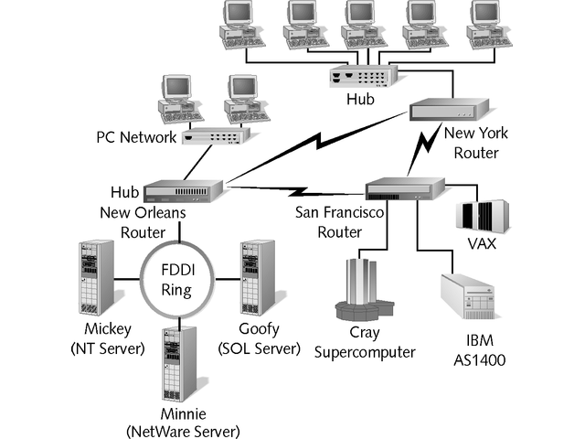
Simple Network Layout Diagram

Slide 38
Chapter Summary
Networks build upon one of three basic topologies
Bus topology is easy to install but is outdated topology not used for new installations
Star topology offers centralized management and higher degree of fault tolerance since single cable or computer failure does not affect rest of network
Star topology is topology choice for today’s networks

Slide 39
Chapter Summary
Ring topology offers computers equal time on network, but network performance degrades when more computers are added
Hub, a central point of concentration for star network, passes electronic signals to network
Active hub regenerates signals
Passive hub simply passes signals along

Slide 40
Chapter Summary
Switch offers greater bandwidth and intelligence, providing significant performance advantages over hubs
Switches have become device of choice in corporate star topology networks
Variations on major topologies allow greater fault tolerance and flexibility
Mesh is most fault tolerant of all network topologies, allowing every computer to communicate with every other computer

Slide 41
Chapter Summary
Star bus or star ring combines centralized management of star and best of bus and ring topologies
Network layout should be consistent with existing network and accurately maintained as network changes
Many third-party tools can assist in design and maintenance

